Slide 1
Assignment 03
By
Kaushik M RAO

Slide 2
Question1
Implementation Exercise #1 • Discuss the database table options available when implementing subtype associations. • Discuss the considerations you would use in choosing one design over the others • Your answer should be in the form of a textual description and possibly graphics (you may use PowerPoint)

Slide 3
Problem1
There can be supertype table with all sub type table attributes mapped to single supertype table.
There also can be a subtype tables with properties of the supertype mapped down into each subtype table.
There also can be a direct mapping {supertype +(set) of subtype) tables.

Slide 4
Supertype Table
We can create a single table which consists of all the attributes of the supertype and the subtype table.
• We can select this option when the subtypes contain only few differences from the data stored in supertype.
• This method eliminates the need of creating joins which are costly as all data can be retrieved from one table.

Slide 5
Sub Type Table
we have created tables for each subtypes, adding attributes of the supertype to each of these tables.
• When the number of common attributes from the supertype table is less, we will implement the subtype tables.
• There is possibility of redundance as the attributes of the supertype will be repeated.
It is good to use Subtype queries when we have many subtype in same query.
It is good to use when there is little sparity.

Slide 6
Subtype tables, each with properties of the supertype
• It is Good approach for high sparsity (subtype)
• It is Good for queries on individual (subtype)
The supertype table will consist of all the attributes that are common between the subtype tables.
We use this option when there are a good number of shared/common attributes and also good b=number of different attributes between the subtype tables.
Here, joins will be required to carry out querying on the tables.

Slide 7
Exercise #2
Selected Semantics
An employee must belong to one and only one department (if a Department is dissolved, the Employee instances must be assigned to another department or be terminated)
A project need not have anyone assigned to it
An employee need not be assigned to a project
Department
Employee
Project

Slide 8
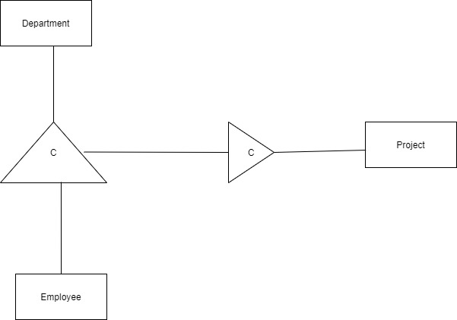
Solution 2

Slide 9
Exercise #3
Shipping Order
Line Item
Supplier
Part
Selected Semantics
A shipping order must include at least one line item
A line item represents a part from a given supplier

Slide 10
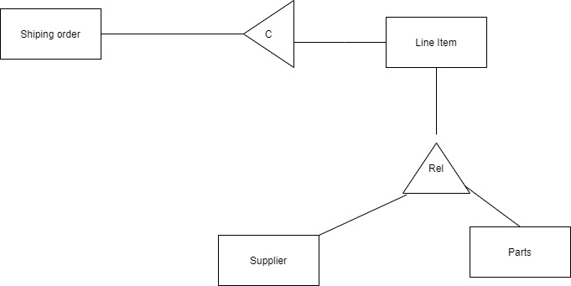
Solution 3

Slide 11
Exercise #4 Hint: Recursion Example
Selected Semantics
Large parts contain small parts
But several small parts contain other small parts
(This is known as the
“parts-explosion” example)
Parts
Large Parts
Small Parts

Slide 12
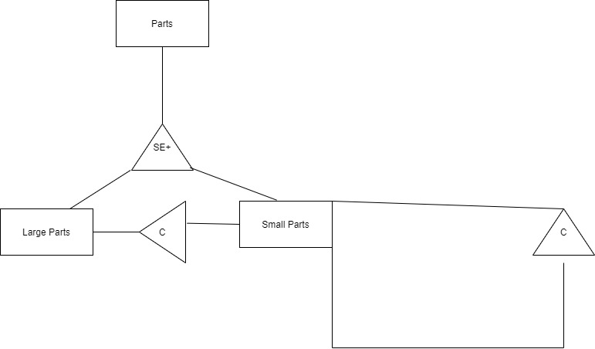
Problem 4

Slide 13
A More Complex Example #5
Doctor
Patient
Subscriber
Symptom
Appointment
Bill
Payment
Insurance Company
Selected Semantics
A patient need not have insurance
Both patient and/or the insurance company may make payments
A bill can have several payments associated with it

Slide 14
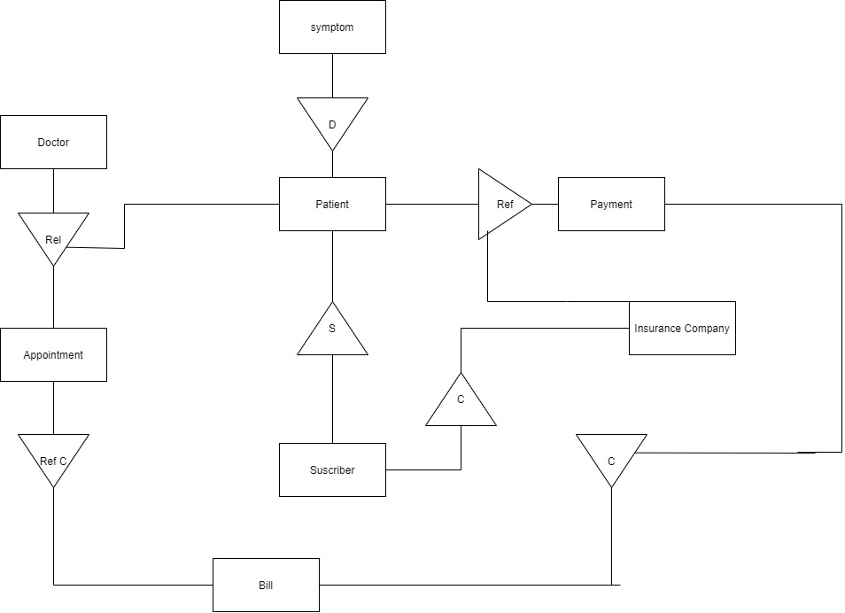
Problem5

Slide 15
Another Complex Example #6
Employee
Department
Office Equipment
Equipment Ownership
Job Classifications
Job Title #1, …Job Title #n
Supervisor
Supervisee
Benefits
Selected Semantics
Office arrangement

Slide 16
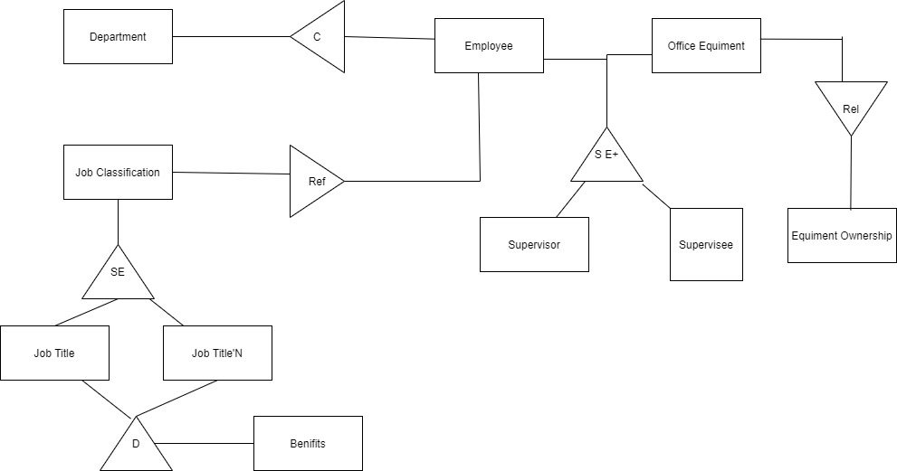
Solution 6

Slide 17
Subtyping Example 7
Subtype the entity “Stevens Community”; that is, the community
Identify the criteria for each subtype
Subtype to 2 or 4 levels
Hint: I’m asking you to subtype the Stevens community (i.e., people), not the Stevens physical structures or policies.

Slide 18
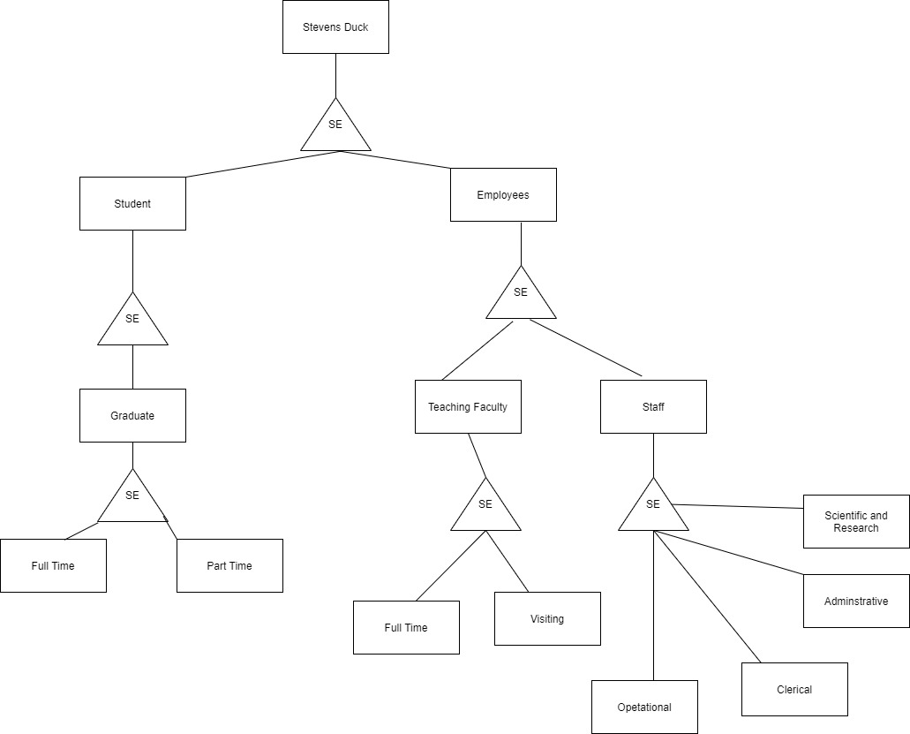
Problem 7

Slide 19
Problem 8
Develop the specifications for a major activity, such as purchasing a new home or purchasing an automobile
The solution should contain a contract map, with a set of interrelated contracts (contract map – see slides #48-50)
The major activity corresponds to the super contract
The super contract level should contain 2 subcontracts (several)
Each contract (super & sub) is to be fully specified in terms of its {invariants, pre-conditions, post-conditions, triggers} (see 2 examples on sides 51-52)
Any major activity is OK (hiring an employee is used as an example on slide 49), keeping in mind the requirement for a contract map, with a specification for a super contract and at least 2 subcontracts
Use slide #49 as a guide. Each contract will be specified as shown in slides #51 or #52

Slide 20
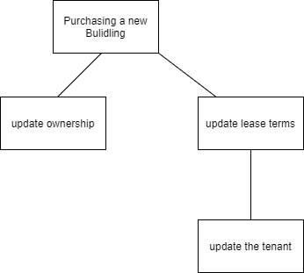
Problem 8

Slide 21
Specification of purchasing a new building
Invariant
• Client needs to find the right property like right location,easy to commute and necessary shops near by.
• Client needs to secure financing from either bank or personal savings.
• Building should be available for purchase

Slide 22
Preconditions
• The building and client exist at the same time
• View availability of the building
• Make an offer for the property for
• Negotiate the offer for
Post Condition
• Client decides what price to pay for.
• Building is no longer available after sold
Trigger
• Offer is finalized when the owner buys the building.
• Client secures finances from the loans or savings.

Slide 23
Specification for Update ownership
Invariant
• Building should be owned by one owner only
Precondition
• The client owns the building
Post condition
• Client’s is legally the owner of the building
Trigger
• Owner name changed to client name

Slide 24
Specification for Update Lease Terms
Invariant
• The building is leased
Precondition
• The lease should be for at least 12 months
• Client creates new lease for all tenants
Post Condition
• New lease for 12 months for all tenants is generated
Trigger
• Client send new lease to all tenants

Slide 25
Specification for Update Tenants
Invariant
• Tenants remains still in the building
Precondition
• New lease is generated by client
• Client has all tenants’ information
Postcondition
• Tenants are updated with the new lease
Trigger
• Tenants sign the lease

